Slide 1
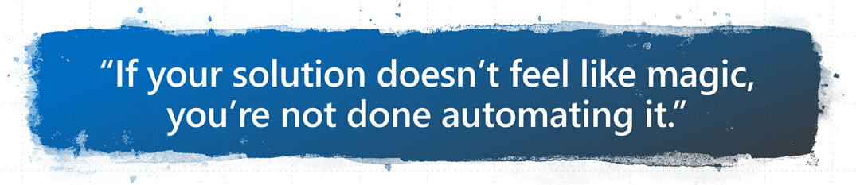
SharePoint Automation with DSC
Nik Charlebois | Senior Premier Field Engineer

Slide 2
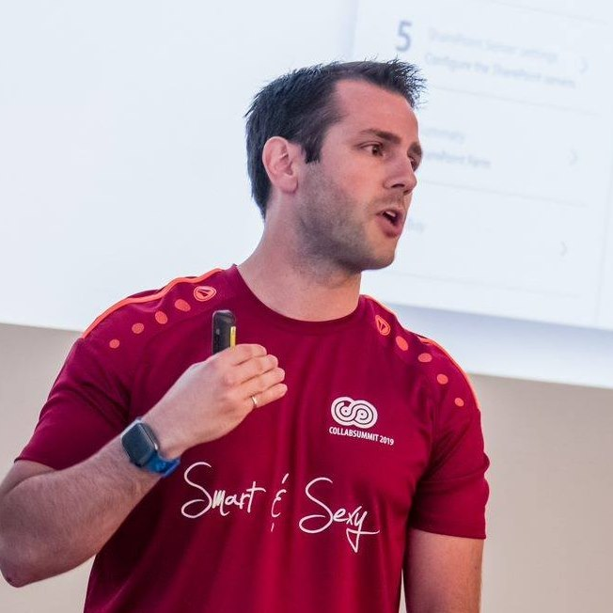
Meet ‏@NikCharlebois
Microsoft Senior Premier Field Engineer
Focusing on SharePoint Development and Automation
Overall DSC goodness evangelist
About Me
Ex-PowerShell MVP
Author of the books Beginning PowerShell for SharePoint 2013 and 2016 & Office 365 Experts
Based in Gatineau, Quebec
Speaker at various technology conference
Blogger at http://NikCharlebois.com
Co-Owner of SharePointDSC and Owner of ReverseDSC & Office365DSC

Slide 3
Setting Expectations
This session is very technical;
About Deployment and Change Management of Config;
By the end of this session, we will have a Fully automated Pipeline;

Slide 4
Agenda
Topics Covered
01 | Introduction to DSC
02 | SharePointDSC
03 | ReverseDSC for SharePoint
04 | Azure Automation DSC
05 | Azure DevOPS

Slide 5
Introduction to PowerShell DSC

Slide 6
Desired State Configuration
Introduced with PowerShell v4.0;
Doesn’t work with SharePoint 2010!
Responsible for bringing machines in their “Desired State” and preventing them from drifting from that ideal state;
Available on:
Windows
Nano
Linux

Slide 7
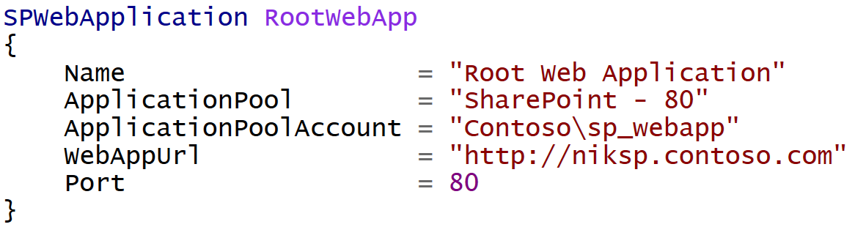
DSC
It’s a Declarative approach;
Notes:
Meaning I don’t tell it do this and then that, but rather here is how I want this, then do whatever in you need to to get me there
Brian: I can ad-lib a good metaphor here to describe the difference between declarative and imperative, if you think there'd be value/interest

Slide 8
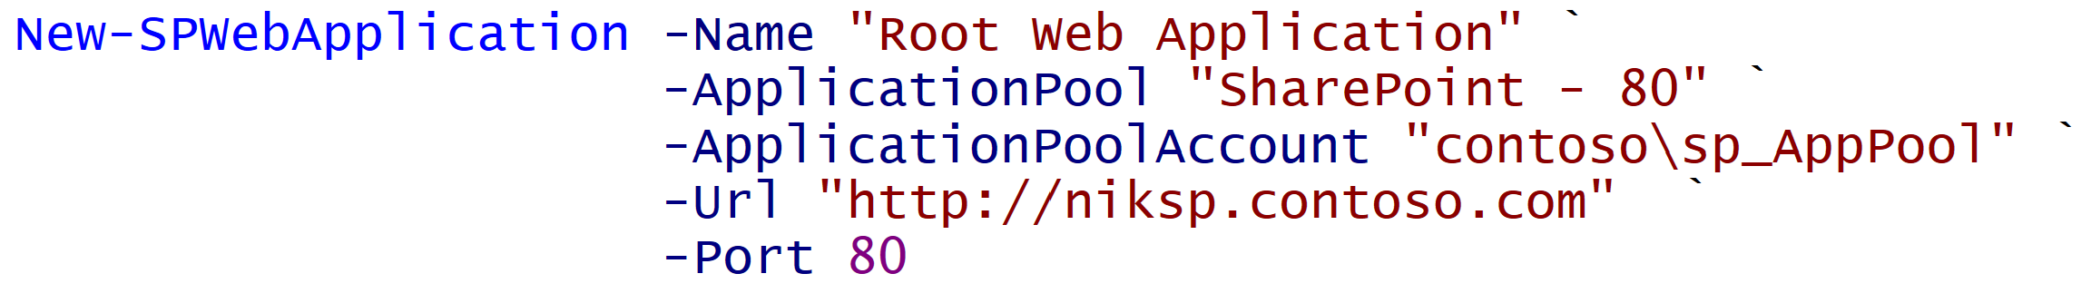
Imperative vs Declarative
Imperative
Declarative
Notes:
Same result. Yes more lines in this example, but ensures it stays in that state.

Slide 9
Why Reinvent the Wheel?
DSC is something completely different;
Does configuration + ensures compliance;

Slide 10
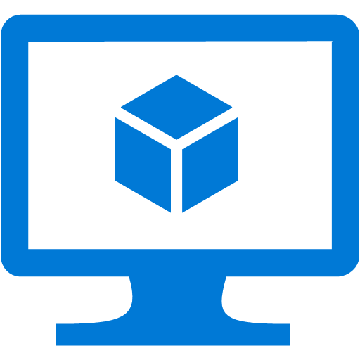
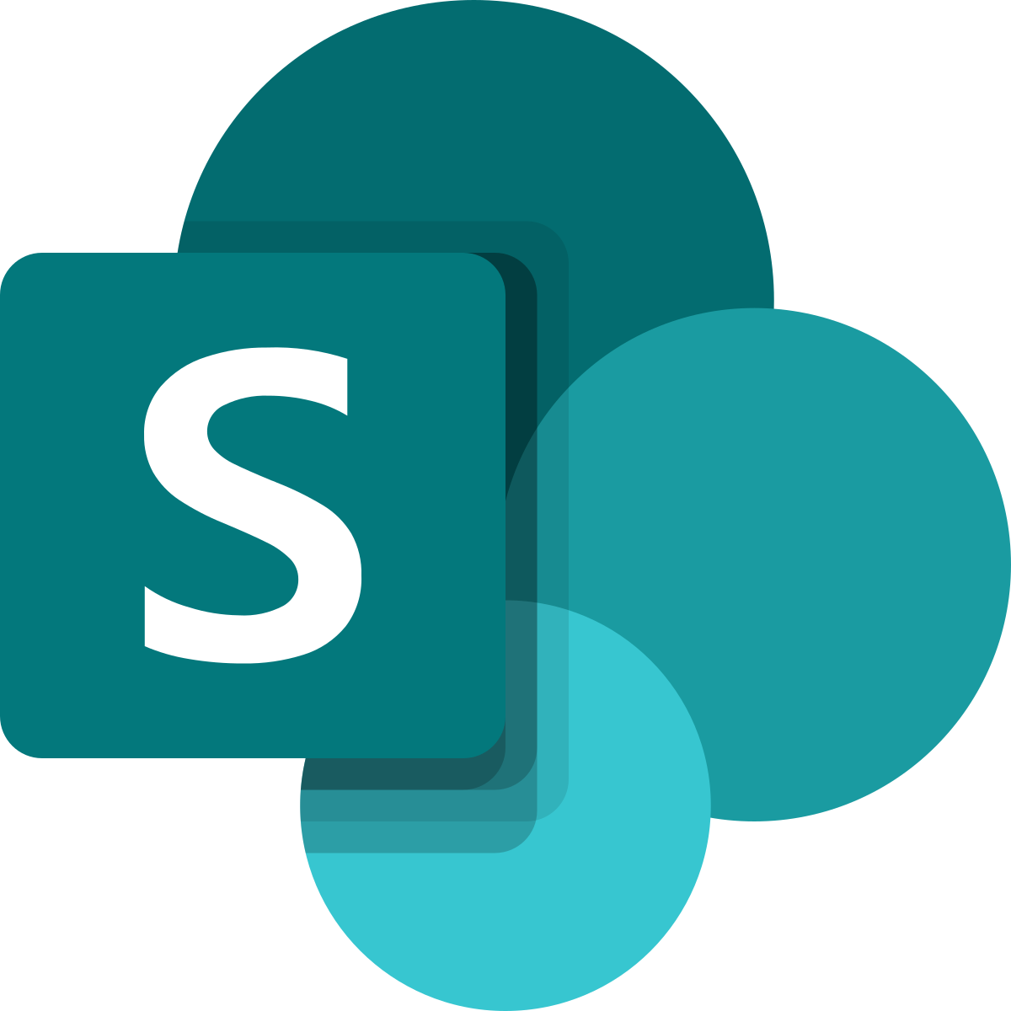
Process
SharePoint Farm
DSC
Deploy Configuration

Slide 11
Process
SharePoint Farm
DSC
Deploy Configuration

Slide 12


Process
SharePoint Farm
Disables Service
Detects Configuration Drift

Slide 13
Monitor Configuration Drifts
+Fix
+Monitor
Default Setting
ApplyOnly
ApplyAndMonitor
ApplyAndAutocorrect
Configure as specified, the done
Configure, and Log Configuration Drifts
Configure, Log & Fix Configuration Drifts

Slide 14
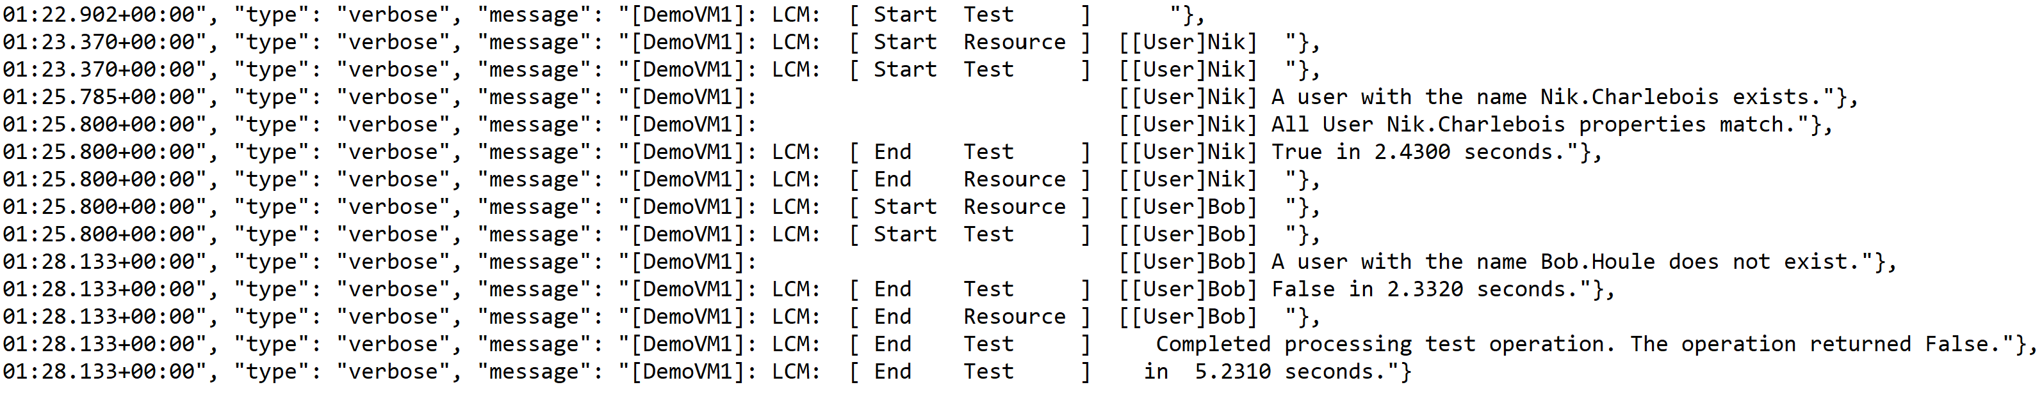
Event Log
All events are stored as .JSON files in C:\windows\system32\configuration\ConfigurationStatus

Slide 15
DSC Configuration Script
.PS1 file that specifies the “Configuration” keyword;
Compiles into a .mof file when executed;
Can use PowerShell logics (e.g. variables, cmdlets, etc.) in its definition;

Slide 16
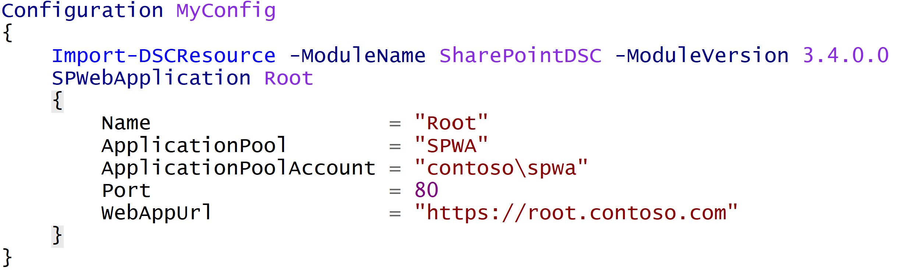
DSC Configuration Flow
DSC
(.PS1 File)

Slide 17

DSC Configuration Flow
DSC
(.PS1 File)
Compile Configuration
MOF

Slide 18
DSC Configuration Flow
Start-DSCConfiguration
MOF

Slide 19
Demo 1
Basic DSC

Slide 20
External Modules
Acquired from the PowerShell Gallery;
Building blocks for our solutions
SharePointDSC
SQLServerDSC
WebAdministrationDSC
ActiveDirectoryDSC
ComputerManagementDSC
NetworkingDSC

Slide 21
PowerShell Modules
Install-Module downloads and installs the module under:
C:\Program Files\WindowsPowerShell\Modules
For isolated environment, simply copy the module folder over;

Slide 22
It’s Still Just PowerShell
Can use classic PowerShell logic inside your configurations;
Conditional Statements;
Loops;
Variables
Etc.

Slide 23
Demo 2
Advanced Configuration

Slide 24
SharePointDSC
Lets you interact with everything that is configurable in Central Administration and more;
Over 110 Resources (SPWebApplication, SPSearchTaxonomy, etc.)

Slide 25

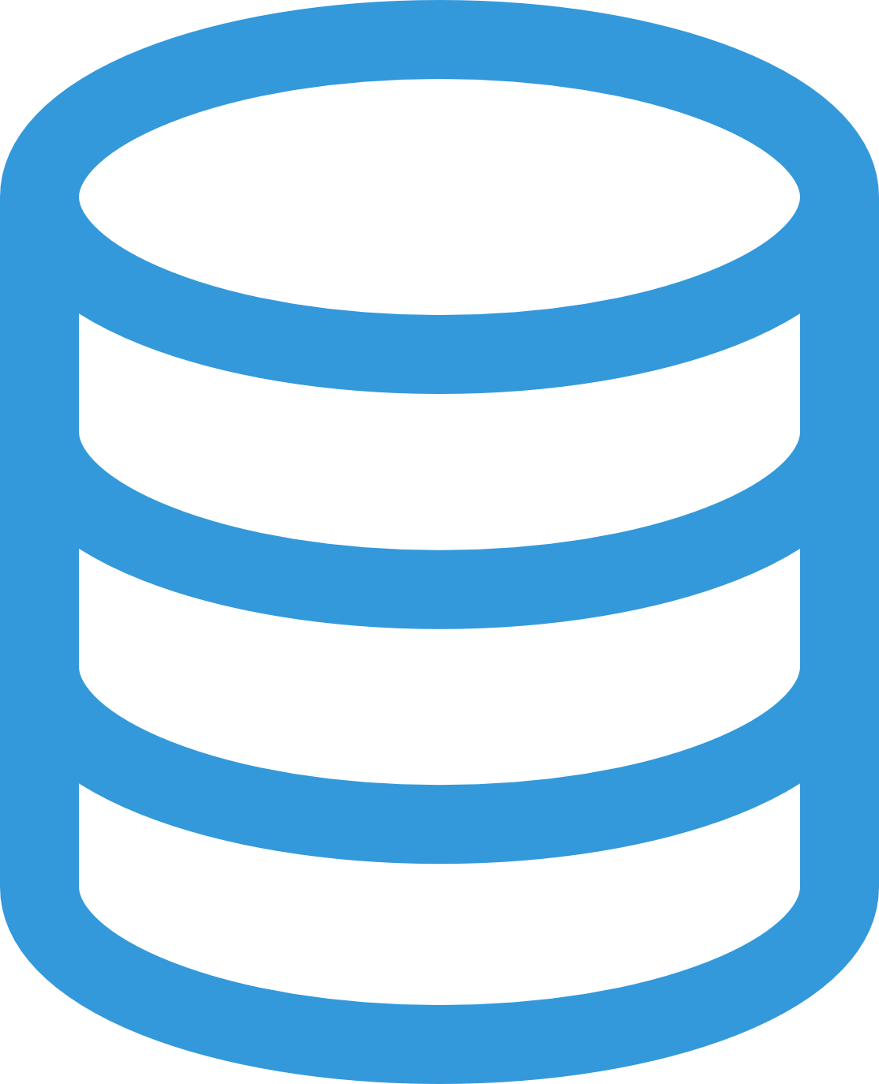
Scenario – 3 Server Farm
https://Github.com/NikCharlebois/Conferences
Domain Controller
Web Front-End
(SP2019)
Application
(SP2019)
Search
(SP2019)
SQL Server 2017

Slide 26
SharePoint Gotchas
Node WFE
{
SPWebApplication WA1
{
…
}
}
Node Application
{
SPWebApplication WA1
{
…
}
}
Node Search
{
SPWebApplication WA1
{
…
}
}

Slide 27
Demo 3
Creating Managed PAths

Slide 28
ReverseDSC
Allows you to extract DSC configuration out of existing environments;
Multiple Scenarios:
Delta Point in Time;
Onboarding existing environments;
Ease Migration;
Document Farm;
Replicate environments;
High Availability;
Etc.

Slide 29
ReverseDSC Roadmap
Will be baked in within every new module we release;
Office365DSC is the first module to have it natively available;
SharePoint on-prem requires us to download an additional script
Install-Script SharePointDSC.Reverse

Slide 30
Demo 4
ReverseDSC

Slide 31
Pull Mode
Requires additional hardware known as a Pull Server;
All .MOF configurations are stored centrally on it;
All DSC Modules are also stored centrally on it;
Connect the servers to it; they pull both configuration and modules from it;

Slide 32
Pull Refresh Mode […]
On a regular basis, the node will ping the Pull Server to check if new configurations are available;
Can manually force a ping using the Update-DSCConfiguration;
Refresh Mode Frequency is 30 minutes by default;
Value can be between 30 minutes and 31 days;

Slide 33
Pull Process

Slide 34
Demo 5
Azure Automation DSC

Slide 35
Azure DevOPS
Manage your config (Source of Truth) in Source Control;
Every code change triggers a Pipeline to deploy in an integration environment;

Slide 36
Demo 6
Azure DevOPS….aka. Putting it all together

